Slide 1
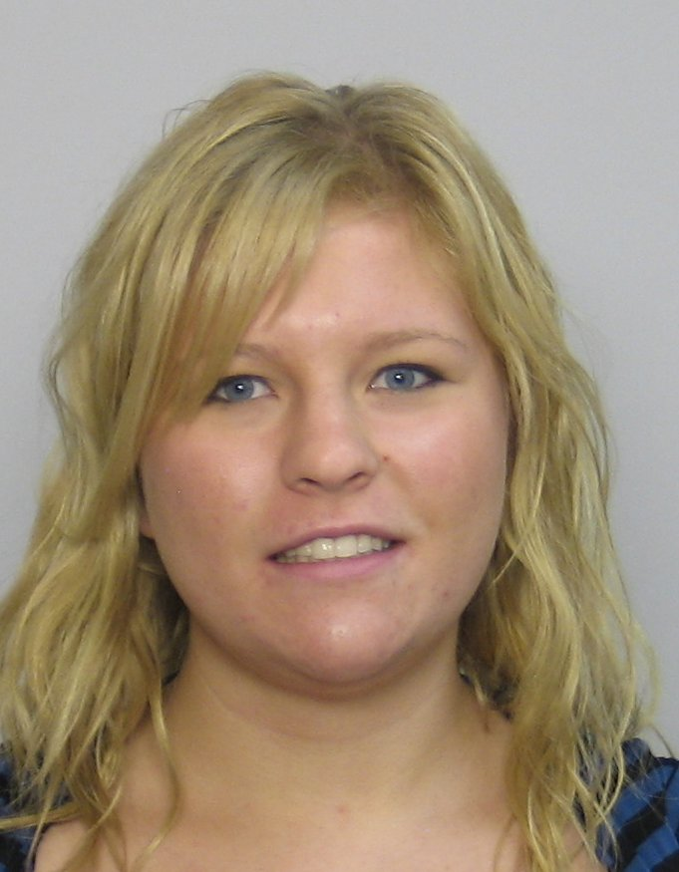
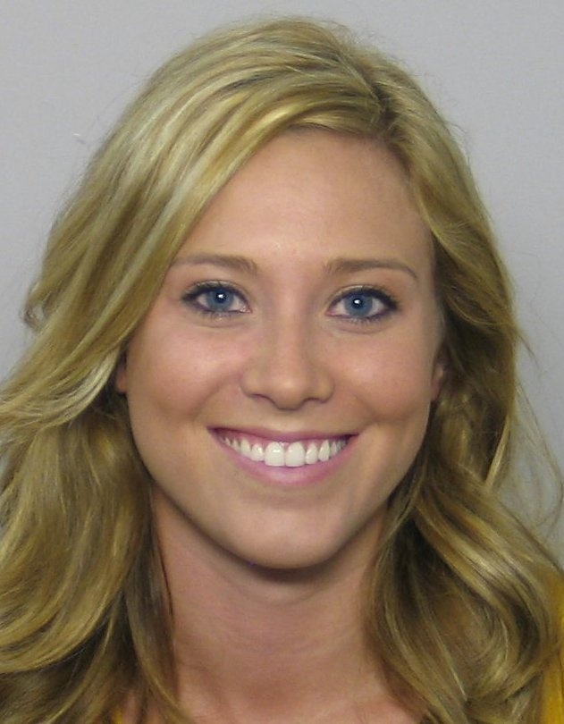
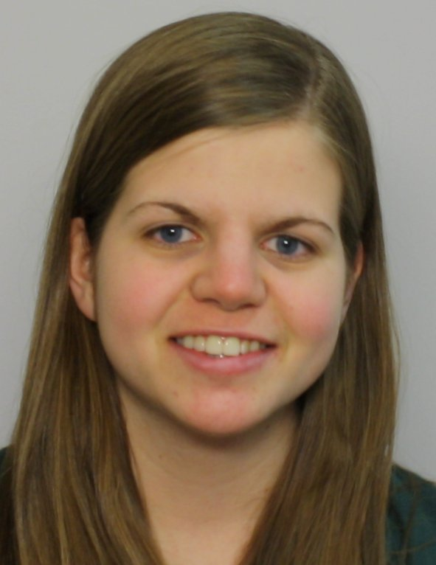
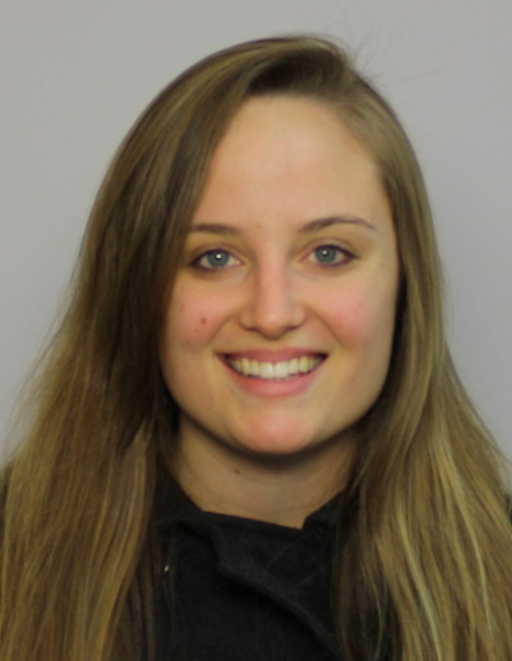
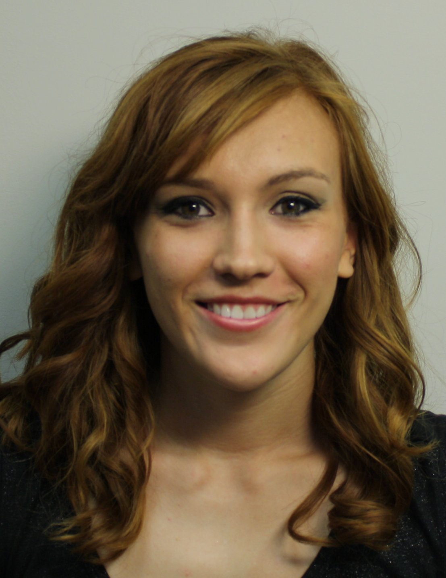
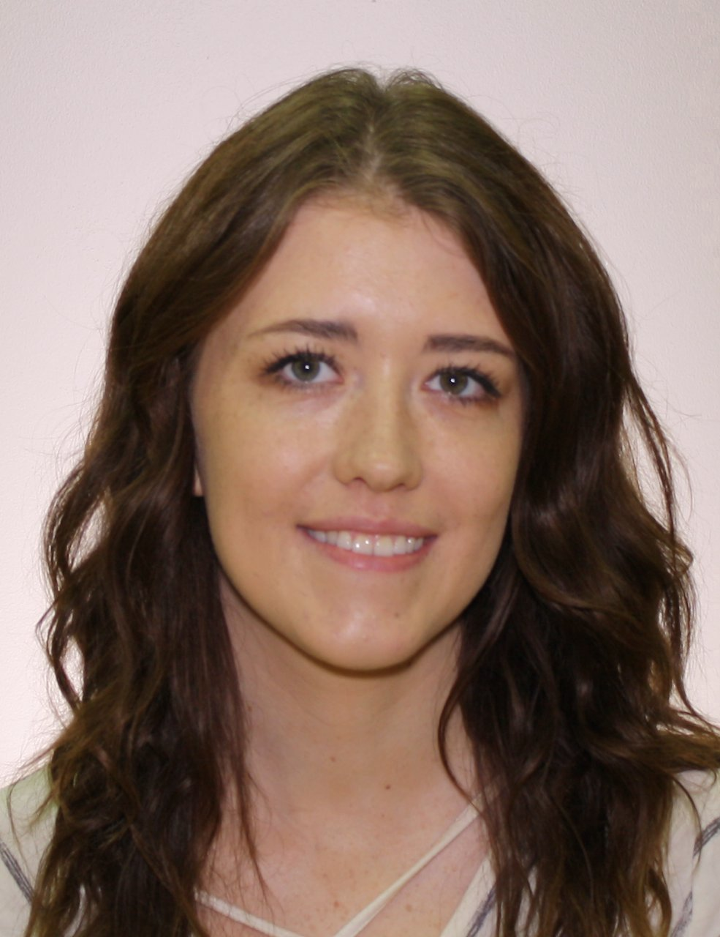
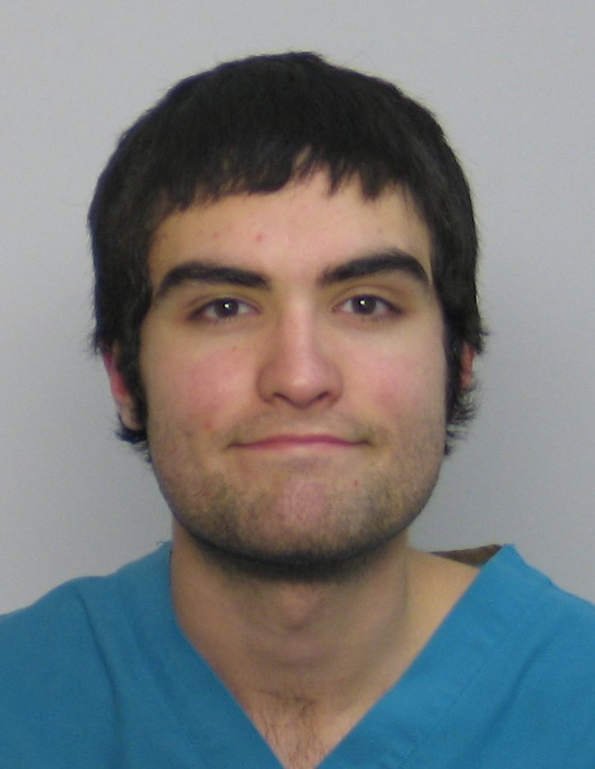
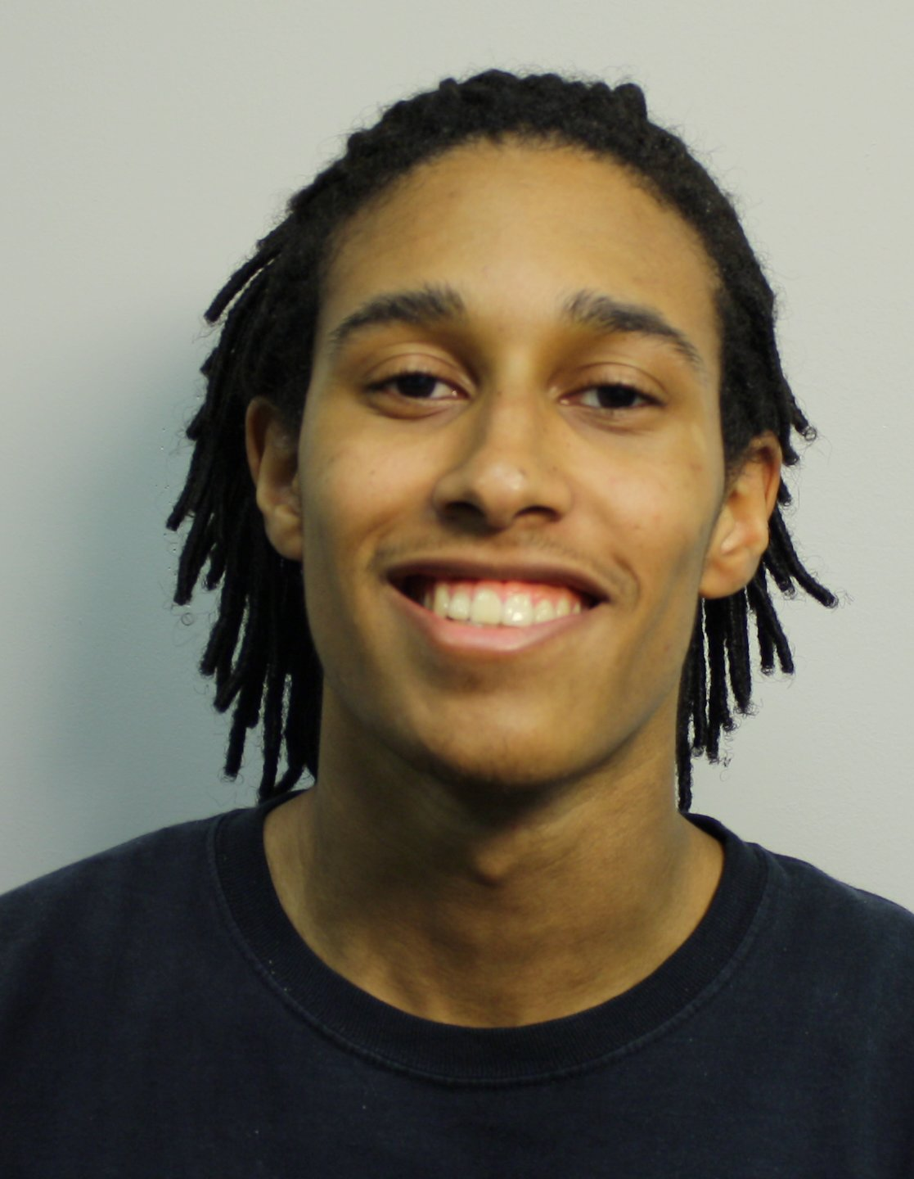
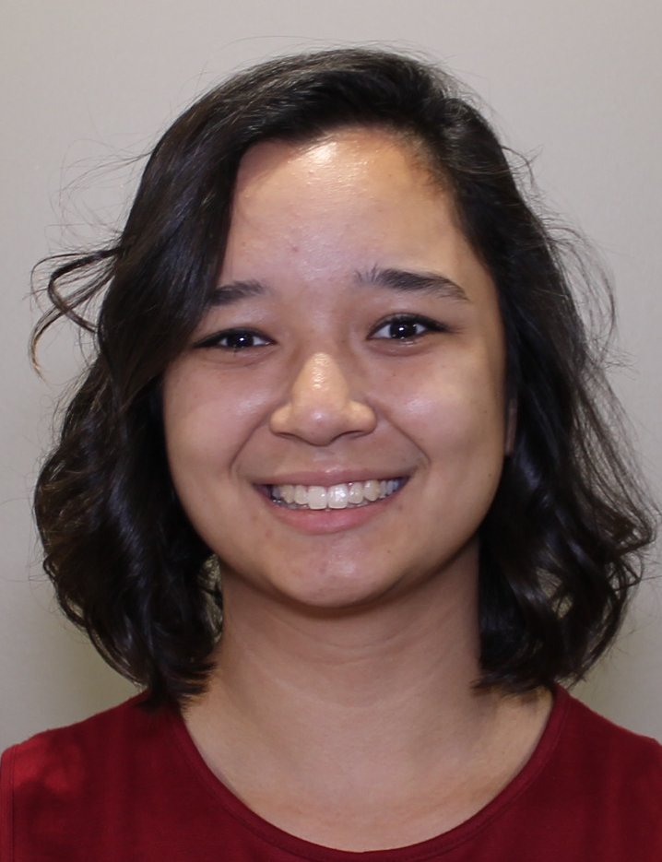
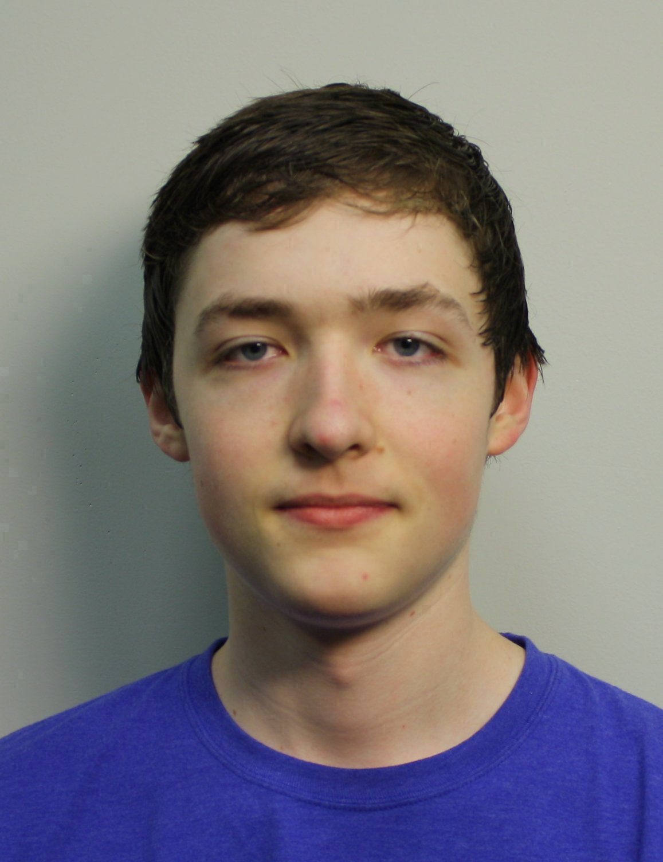
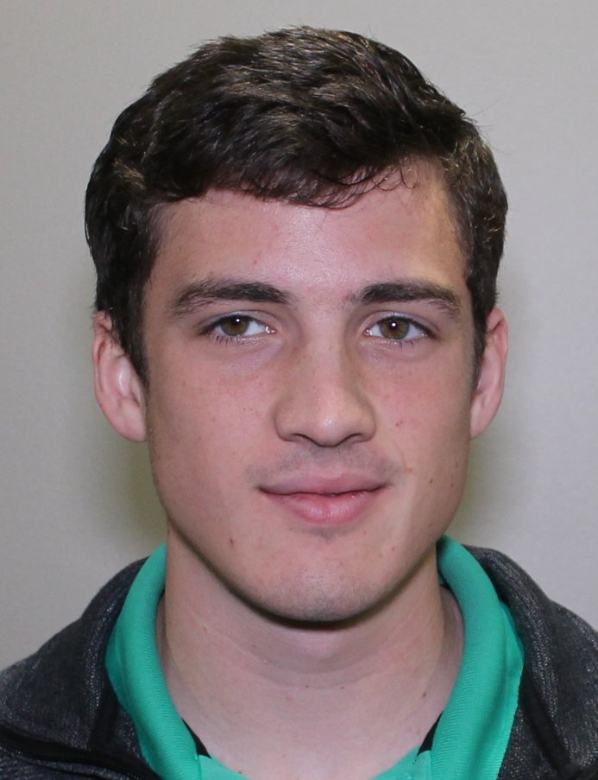
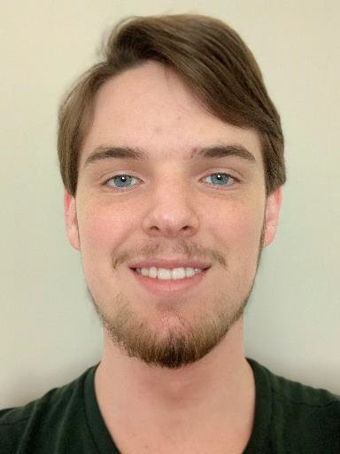
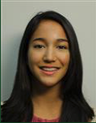
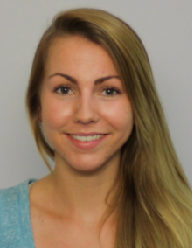
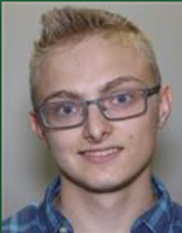
W11
Engineering
Engineering
Mathematics
Biophysics
Mathematics
Math/Chemistry
Breanna Bowden-Green
Kelsey Dobbs, W10
Amy Bead W12
Christen Case
F14
Camille Morrow
W18
Victoria Kratzke
W20
1. Human inspection of networks.
2. Mathematical treatment of network properties.
3. Improved enumeration & acceleration.
Nursing
Biochemistry
Mathematics
Computer Sci.
CPTR Sci/Emb.Sys
Computer Sci.
Bio/Premed
Lucas Valenca, F16
Drew Blake, W17
Sarah Wu
W20
4. Logic & Planning
Josh Wade
W20
Jonathan Ziesmer, W21
Miro Manestar
Physics
5. Programming
Jade Deschamps
S19
Biophys/Spanish
6. Translation
Researchers in the SESSIE project Southern Adventist University
Jeanna Toulouse
W19
Christofer Trana
W19
7. Identifying Networks Mathematically

